Slide 1
Homework 5
Front-End Web Development

Slide 2
Homework Assignment
In this homework you will:
Use responsive design strategies to recreate the Slack site’s navigation.
Use the position property to implement dynamic menus.
Learn about transitions and dropdown menu UI patterns.

Slide 3
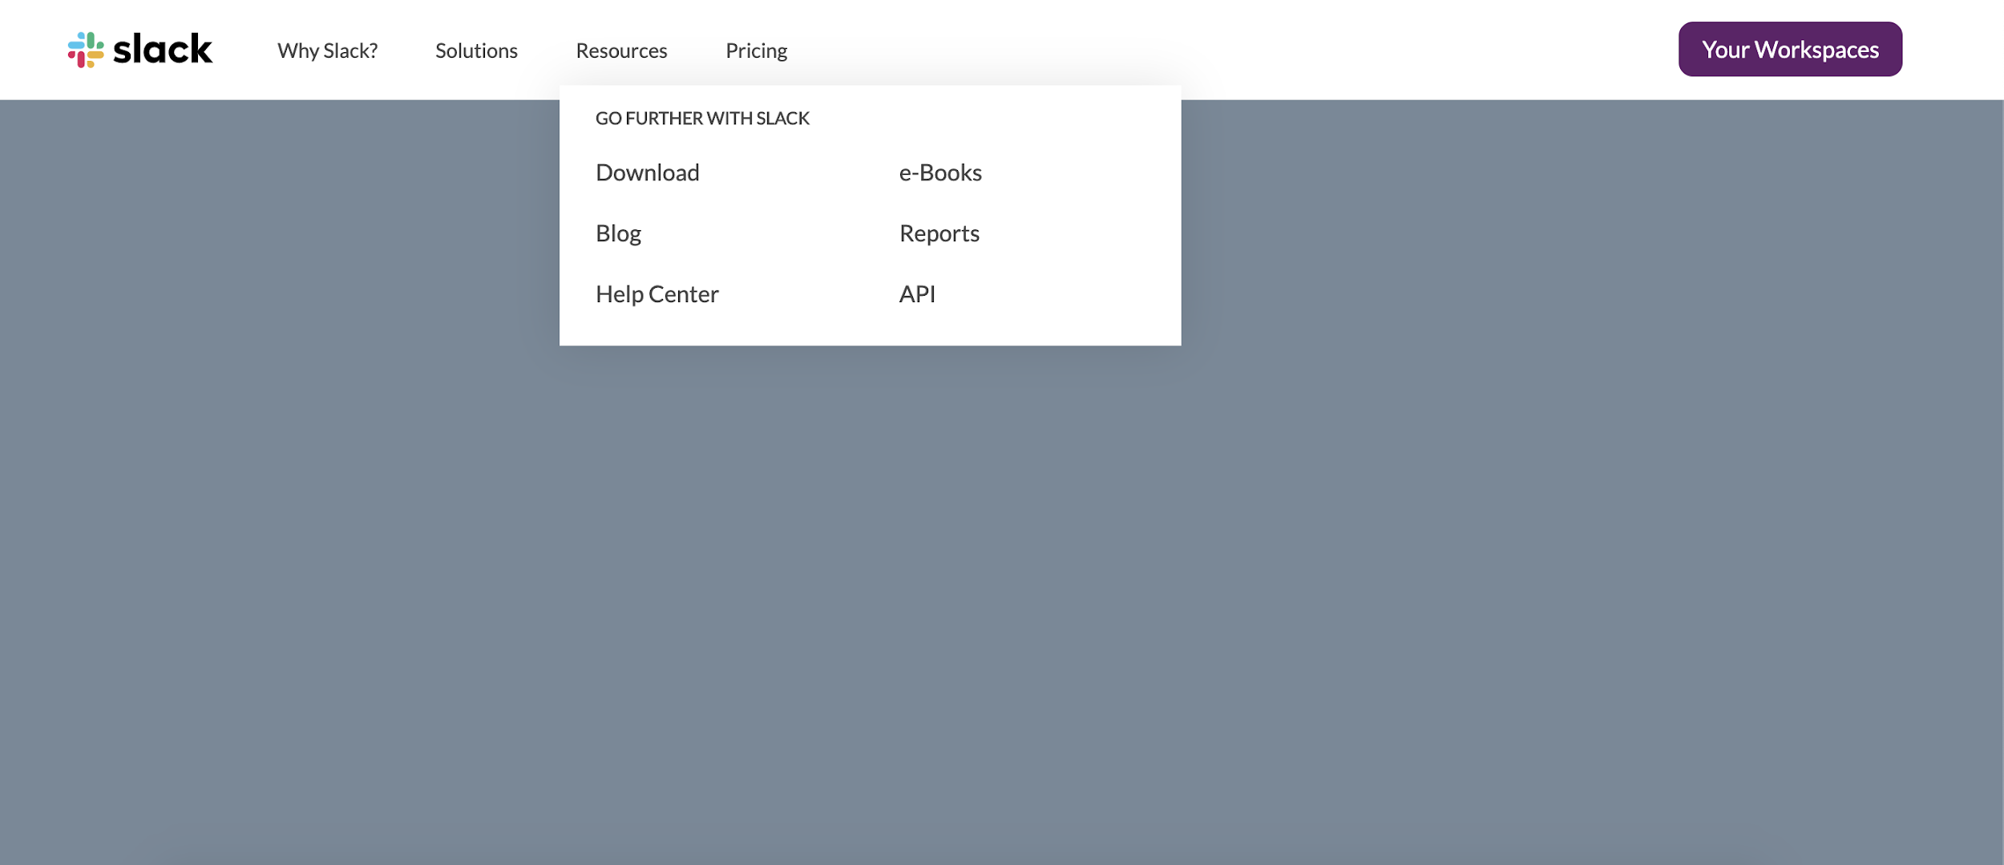
Assignment: Rebuild a Navbar From Slack
We use Slack a lot at GA, so why not build a site for the company that lets us communicate with each other?
The whole site is a big challenge, but we can break the assignment down into something more manageable by concentrating on the header and navigation elements.

Slide 4
View the Completed Solution
https://codepen.io/GAmarketing/pen/gOpRJjz
Check out the solution in your browser to see how this site should look. It’s interactive, so play around with it a bit (change the browser window width to see responsive behavior, etc.).

Slide 5
The Goal
We’re giving you the layout of the page with the header already in place. Your job is to get the menus up and running, both for desktop and for mobile. You’ll have to use responsive design and the position property and build the menus in HTML. All of the other HTML, baseline CSS, and SVG icons are provided.
Starter code: https://codepen.io/GAmarketing/pen/jOPwjVE

Slide 6
Challenge 1: Dropdown Menus
The menus for each item in the main nav are called dropdowns, or sometimes tooltips. They pop up when you hover over the menu item. Explore how this works.
Think about the elements with which you’re interacting. When does the menu show up? Why? When does it go away? Which specific elements are involved? How do you target them?

Slide 7
Challenge 2: Off-Canvas Pattern
The responsive off-canvas menu can be triggered very easily. It looks complicated, but think about it: You’re just capturing one click event and then adding a class to create the interaction. It’s way less JavaScript than you think! The magic is in the CSS, if you do this correctly. Look at the solution for clues if you get stuck.

Slide 8
Bonus Challenge: Building Dropdowns
If you want to push your skills further, try building the entire interface, side menu, and dropdowns (in HTML, CSS, and JS). This will be a difficult, probably multi-day assignment. Remember, you can always refer to the solution for help as you progress.
Harder starter code: https://codepen.io/GAmarketing/pen/ExjXBOQ
Resources: https://css-tricks.com/guide-responsive-friendly-css-columns/

